Slide 1

Women safety

Slide 2

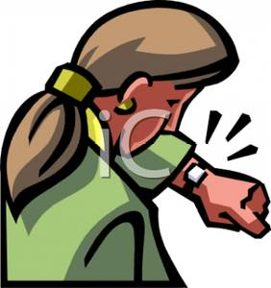
In case of Emergency….
Emergency Call
to Police
GPS Location
as a SMS
Emergency Call to Relatives
GPS Location
as a SMS

Slide 3
Features:
Touch alarm system for women’s safety using GSM and GPS.
Here we introduce a device which ensures the protection of women. This helps to identify protect and call on resources to help the one out of dangerous situations.
Anytime you senses danger, all you had to do, is hold on the button of the device.
The system resembles a normal watch which when activated, tracks the place of the women using GPS and sends emergency messages using GSM emergency contacts and the police control room.
The main advantage of this system is that the user does not require a Smartphone unlike other applications that have been developed earlier.
The use of sophisticated components ensures accuracy and makes it reliable.

Slide 4
The device will send longitude and latitude continuously until the device is resetted with secret key.

